Slide 1



Hepatitis B
Understanding Hepatitis B and
Promoting Testing in
Micronesian Immigrant Communities
A guide for community health workers, health educators, medical staff and other professionals

Slide 2



Why should i learn about hepatitis B?

Slide 3

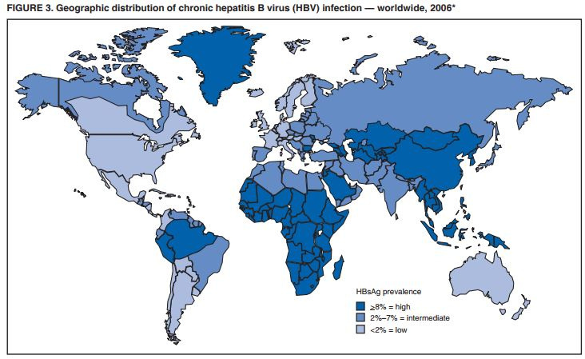


Because...
PAGE | 00
Hepatitis B is one of the world's most common infections.
Hepatitis B is more common among people who were born in the Pacific Islands and other parts of the world.

Slide 4

PAGE | 00
What is Hepatitis B?
Hepatitis B is a virus that attacks the liver and that
can cause serious liver disease and even liver cancer.

Slide 5





Keeping your liver healthy is important
because it has many jobs in your body.
Digests food.
Gives you energy.
Builds muscle.
Breaks down toxins.
Fights infections.
Breaks down medications.
Stores vitamins.
Helps the blood to clot.

Slide 6


People cannot live without their liver!

Slide 7


The good news:
PRESENTATION TITLE | QUOTE
PAGE | 00
If they see a doctor regularly,
people can live with hepatitis B for a long time.
You can help keep your community healthy by learning about hepatitis B.
By taking care of their health, people can have a long and healthy life!

Slide 8
You can help keep your community healthy by learning about hepatitis B and sharing what you learn with others.

Slide 9



The Basics of
Hepatitis B

Slide 10


Hepatitis B is one of the world's most common infections.
Worldwide
Almost 300 million people
are living with hepatitis B
In the United States
About 2.4 million people have
hepatitis B.

Slide 11





Most people living with hepatitis B
don’t know it!

Slide 12

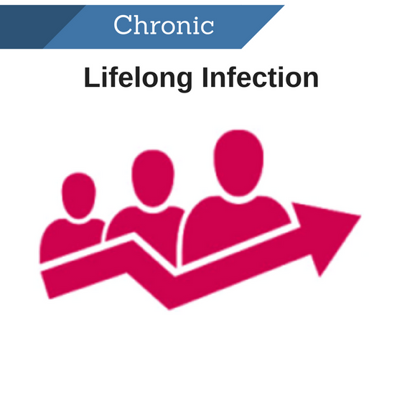
PAGE | 00
There are two kinds of hepatitis B infections.
Acute
Chronic
Short-term infection
Lifelong infection

Slide 13
PAGE | 00
The age when someone gets the virus
usually leads to different types of infections.
Acute
Chronic
An infection that lasts
less than 6 months
An infection that lasts for life
  Less common
  Usually happens when an adult gets the virus
  Usually clears from the body within 6 months
  More common
  Usually happens when a child gets the virus
  Usually lasts for life

Slide 14


Although hepatitis B can be prevented with a vaccine at birth, not all babies get the vaccine.
Many pregnant people do not know they have the virus, and pass it to to their babies without knowing.
If babies get the virus and don’t get the vaccine, they will usually have to live with hepatitis B for life.

Slide 15


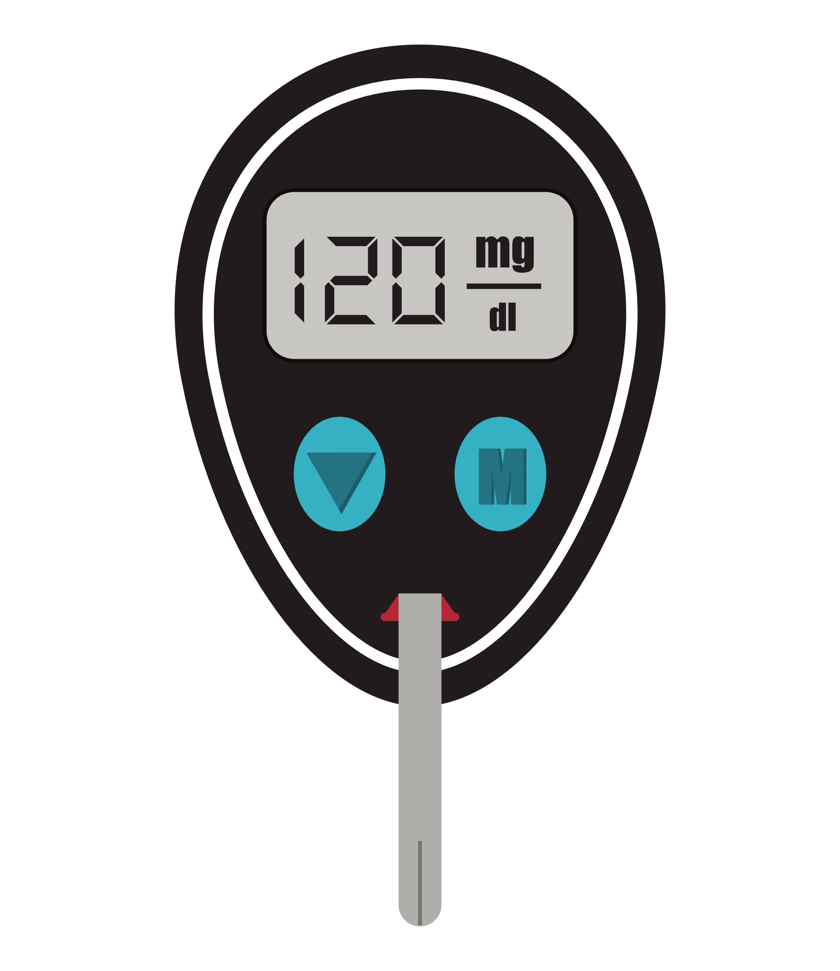











Someone can also get hepatitis B through:
Intimate contact
Blood
Direct blood to blood contact
Direct contact with bodily fluids of someone living with hepatitis B
Mother to child during birth
Healthcare exposures
Household contact
Sharing hygiene equipment
(razors, toothbrushes, earrings etc.)
Unprotected Intimate Contact
Tattoos, piercings, barbers,
scarification, circumcision practices
There is a risk during any type of intimate contact
Sharing needles

Slide 16








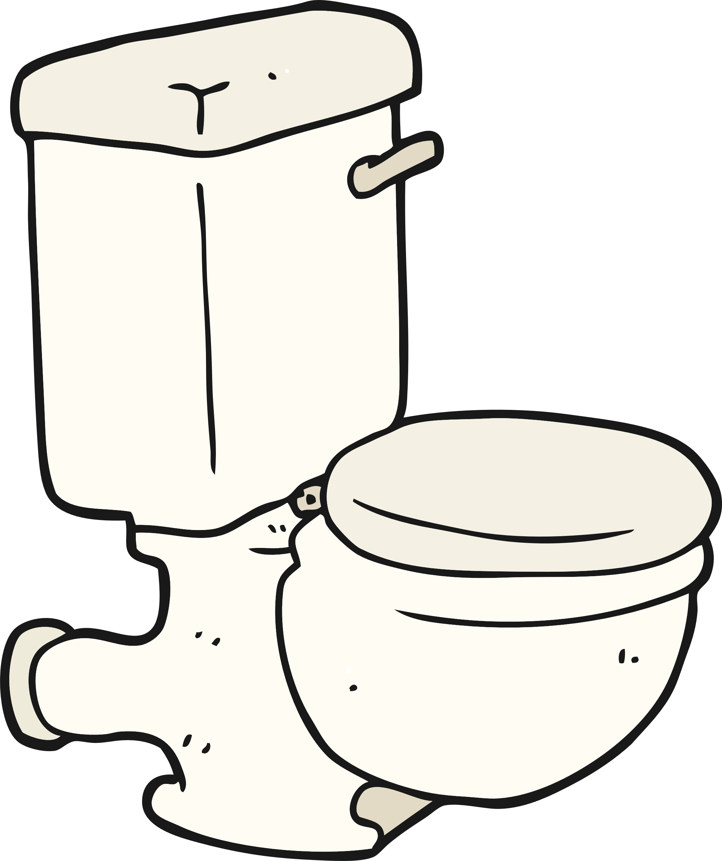

NOT
Hepatitis B is spread by:
Food
Sneezing or coughing on someone
Touching
Or sharing meals with someone who is living with hepatitis B.
Hugging
Water
Breastfeeding
Drinking from the same cup as someone who is living with hepatitis B or sharing a toilet
Kissing

Slide 17

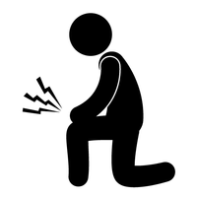




Fewer than 10% of people living with
chronic hepatitis B have symptoms.
If someone with chronic hepatitis B does show symptoms,
it usually means their liver has a lot of damage:
Yellow skin or eyes, stomach pain,
vomiting, feeling tired, joint pain, dark urine or clay-colored stool

Slide 18
Hepatitis B can lead to liver disease and liver cancer
If people ignore hepatitis B, they are at
much higher risk for liver disease and liver cancer
Progression of liver disease
Healthy Liver
Liver Fibrosis
Liver Cirrhosis
Liver Cancer

Slide 19
Although hepatitis B is common among Pacific Islander populations, most people do not know they have the virus.
People can be afraid to get tested. They may incorrectly believe they would have symptoms, may hold on to common myths, or may not have health care available to them.
Not knowing your hepatitis B status is a health risk.
Without regular healthcare and possible treatment, a person living with hepatitis B is more likely to face early death or passing the virus on to others.

Slide 20
The CDC now recommends that all adults in the United States be tested for hepatitis B at least once in their lifetime and that all adults between the ages of 19 and 59 (as well as high-risk adults ages 60+) be vaccinated against hepatitis B.

Slide 21
The test for hepatitis B is a simple blood test.
It can be done at a family doctor, liver specialist or at a community health fair.
It is quick and easy and the results will be ready in a few days.

Slide 22
After someone is tested:
______
______
______
______
______
______
______
______
______
______
______
______
If the test results show that
______
______
______
______
______
______
______
______
Someone is NOT living with hepatitis B
  They should get vaccinated to prevent hepatitis B
Someone is living with hepatitis B
  They should see a doctor for more testing
  Have family members and sexual partners tested

Slide 23
People who test positive for hepatitis B can stay healthy by:
Seeing their doctor 1-2 times a year.
  A doctor who knows about hepatitis B is best
  They will do more tests and, if needed, offer treatment
Leading a healthy lifestyle.
  Eating healthy food
  Getting lots of exercise
  Avoiding alcohol and cigarettes
These can be dangerous for the liver

Slide 24
There is no cure for chronic hepatitis B.
Claims that medicine or herbal remedies can cure the virus are NOT true.
CANNOT CURE
CANNOT CURE

Slide 25
PAGE | 00
There are treatments for hepatitis B.
But, the good news is that...
There are good treatments, called antivirals, that can control the virus and keep the liver healthy.

Slide 26


PAGE | 00
Why should people get tested for hepatitis B?
Hepatitis B can be managed and treated!
Most people do not have symptoms.
Someone should not wait until they feel sick.
They should get tested now!
There is a safe vaccine that works and that can protect loved ones who don't have hepatitis B.
Getting tested now can allow someone to stay healthy for themselves and their loved ones!

Slide 27
You have the power to save lives by:
  Educating about hepatitis B
  Promoting testing in your community

Slide 28
PAGE | 00
Talking about hepatitis B in a
culturally sensitive way can be challenging.
Knowing the common myths and how to overcome them can help reduce stigma and share accurate information.

Slide 29
Myth #1:
PAGE | 00
Symptoms
I don't have any symptoms.
Could I still have hepatitis B?
Yes.
Most people
with hepatitis B
do not have
any symptoms!

Slide 30
Fact #1
PAGE | 00
Most people with hepatitis B don’t have any symptoms.
Remember:
People may be used to treating illnesses only when they have symptoms. People may not feel a need to get tested if they feel fine.
Key Tips:
  Let community members know that people with hepatitis B often have no symptoms, even though their liver could be damaged.
  Remind people that they have the power to improve their health now, to prevent serious liver problems in the future.
  The hepatitis B test is a simple blood test. It is the only way to know if someone has the virus!

Slide 31
Myth #2:
PAGE | 00
Misconception #2
PAGE | 00
Transmission
I haven’t done anything risky to get hepatitis B.
Could I still have it?
Yes.
Most people
get hepatitis B as babies or children.

Slide 32
Fact #2
PAGE | 00
Most people living with hepatitis B got the virus at birth or as young children.
Remember:
Some people think about unhealthy or risky behaviors when they think about hepatitis B. People may not know how most people get the virus.
Key Tips:
  Stress that the most common way hepatitis B is passed from person to person is through blood contact at birth or contact with blood of someone living with hepatitis B during early childhood.
  Reminding community members that hepatitis B is one of the world’s most common viruses may be helpful in normalizing testing.

Slide 33
Myth #3:
Misconception #3
PAGE | 00
PAGE | 00
Medical Care
Are there treatments for hepatitis B?
Yes.
Treatments are available that can help people stay healthy.

Slide 34
Fact #3
PAGE | 00
Treatments are available that can help people stay healthy.
Remember:
People may be worried that there is no cure for hepatitis B and that a hepatitis B diagnosis will change their whole life – but it doesn’t have to!
Key Tips:
  People with hepatitis B can still live long, healthy and productive lives.
  Hepatitis B usually progresses slowly. The biggest danger is not knowing if you have the virus!
  Hepatitis B can be managed over time by seeing a doctor and taking treatment if it is needed.

Slide 35


Be Aware:
There can be stigma and fear linked to hepatitis B.
Let's learn more about how to overcome these barriers when educating.

Slide 36
Dispelling Stigma: Misinformation
PAGE | 00
Stigma can come from misinformation.
Misinformation can lead people to assume how someone may have gotten the virus.
People may assume that people have gotten hepatitis B through:
  Immoral behavior
  Drug use
  Having many sex partners

Slide 37

Dispelling Stigma: Misinformation
PAGE | 00
To overcome misinformation, emphasize the facts!
People most commonly get hepatitis B from:
  Their mothers during birth
  Contact with blood from someone living with hepatitis B during early childhood
Anyone can get hepatitis B no matter their cultural or religious values

Slide 38
Dispelling Stigma: Fear
PAGE | 00
Stigma can also come from fear.
  Being seen getting tested
  Managing the virus
    Cost
    Seeing a doctor regularly
    Family burden
  Social stigma
    Isolation from friends and family
    Community judgment

Slide 39
Dispelling Stigma: Fear
PAGE | 00
To overcome fear, normalize hepatitis B testing and emphasize available resources.
  Resources are available to help people living with hepatitis B.
  Hepatitis B is a very common virus, and can be managed well by seeing a doctor and making simple lifestyle changes.
  The more correct information the community knows, the less stigma there will be around hepatitis B!

Slide 40
PAGE | 00
You play an important role in your community,
and you have the power to promote awareness and testing for hepatitis B!
Key tips:
Always listen to people’s concerns. Always encourage community members to become empowered and proactive about their health, so they can stay healthy for themselves and their families.
If someone tests positive for hepatitis B, there are many resources available to help them manage the virus, even if they do not have insurance.
A hepatitis B diagnosis isn't a death sentence, and by living a healthy lifestyle and keeping an eye on the virus with a doctor, people can live long and productive lives!

Slide 41
PAGE | 00
You are not alone! There are resources available to help:
How can I find doctors for testing and care?
The Hepatitis B Foundation's Liver Specialist Directory
www.hepb.org/physiciandirectory
Federally Qualified Health Center (FQHC) Locator
www.findahealthcenter.hrsa.gov
Where can I find more information on hepatitis B?
Centers for Disease Control and Prevention (CDC)
  Basic information about hepatitis B, guidelines and downloadable PDFs
  Printable fact sheets, PSA videos, infographics, quizzes and more in many languages
  Free posters
www.cdc.gov/knowhepatitisB
The Hepatitis B Foundation
  Phone and email helplines
  Comprehensive information
  Printable fact sheets
  Inspiring videos from real people living with hepatitis B
www.hepb.org

Slide 42
There are many ways that you can provide hepatitis B education in your community.
Talk to community members about their health and hepatitis B risk.
Display educational fact sheets, brochures and posters in your office.
Host an education session, health fair or hepatitis B testing event.
Promote a local health fair that is testing for hepatitis B.
Share CDC's and the Hepatitis B Foundation's posts on social media.

Slide 43
PAGE | 00
Thank you for helping
spread the word about hepatitis B!

Slide 44
PAGE | 00
After viewing this presentation, please complete a short self-assessment.
Click Here!
Your feedback can help us provide you with the most useful resources!
For questions or additional support, email: info@hepb.org

