Slide 1


DRAFT

Slide 2


Slide 3
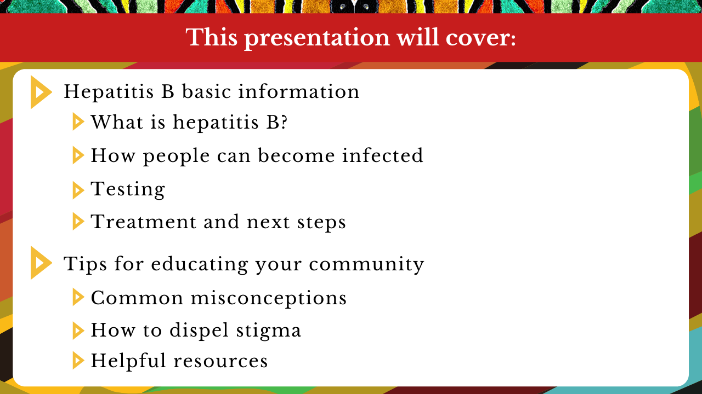

Slide 4


Slide 5
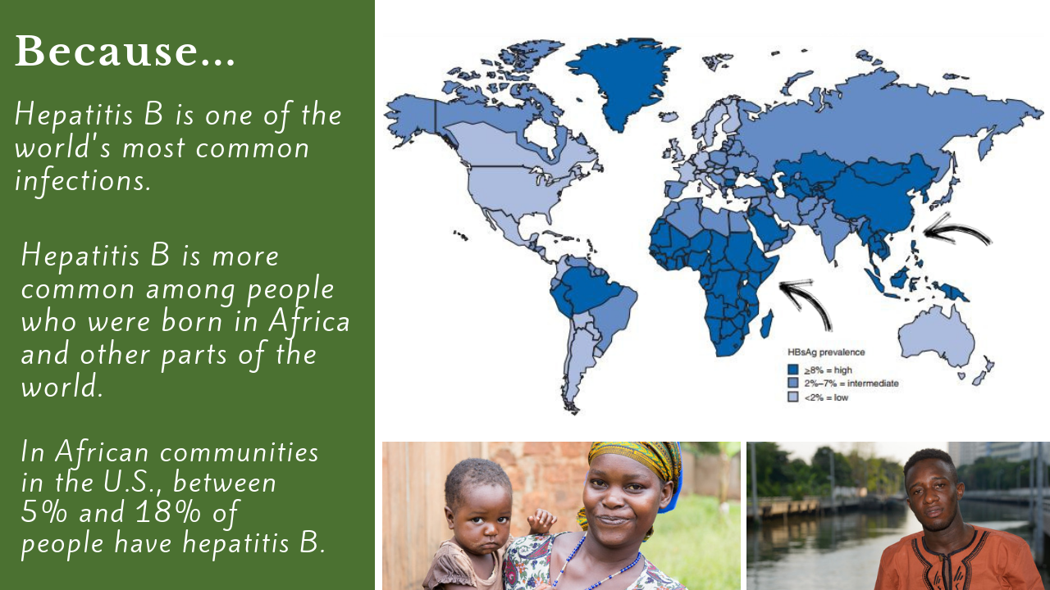
Notes:
Mitchell, T., G. L. Armstrong, D. J. Hu, A. Wasley, and J. A. Painter. 2011. The increasing burden of imported chronic hepatitis B—United States, 1974-2008. PLoS ONE 6(12):e27717.
Chandrasekar, E., Song, S., Johnson, M., Harris, A. M., Kaufman, G. I., Freedman, D., et al. (2016). A novel strategy to increase identification of African-born people with chronic hepatitis B virus infection in the Chicago metropolitan area, 2012-2014. Preventing Chronic Disease, 13, E118.
Edberg, M., Cleary, S., & Vyas, A. (2011). A trajectory model for understanding and assessing health disparities in Immigrant/Refugee communities. Journal of Immigrant and Minority Health, 13(3), 576-584.
Kowdley, K. V., Wang, C. C., Welch, S., Roberts, H., & Brosgart, C. L. (2012). Prevalence of chronic hepatitis B among foreign‐born persons living in the united states by country of origin. Hepatology, 56(2), 422-433.
Ugwu, C., Varkey, P., Bagniewski, S., & Lesnick, T. (2008). Sero-epidemiology of hepatitis B among new refugees to Minnesota. Journal of Immigrant and Minority Health, 10(5), 469-474.

Slide 6



Slide 7


Slide 8
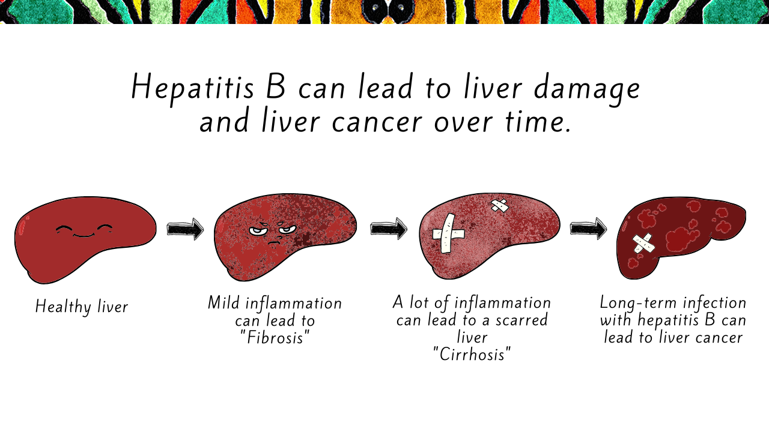

Slide 9


Slide 10


Slide 11


Slide 12
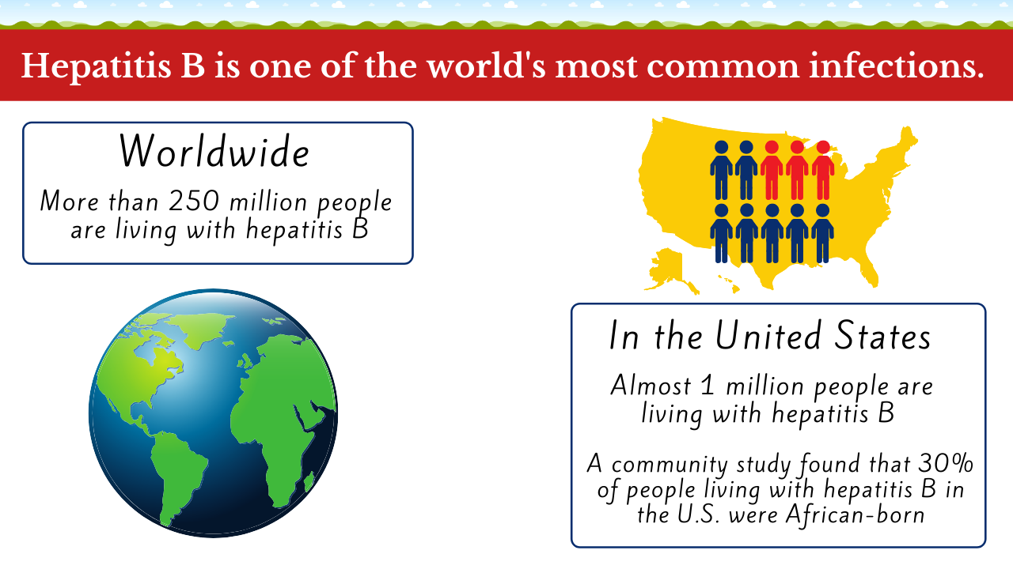

Slide 13
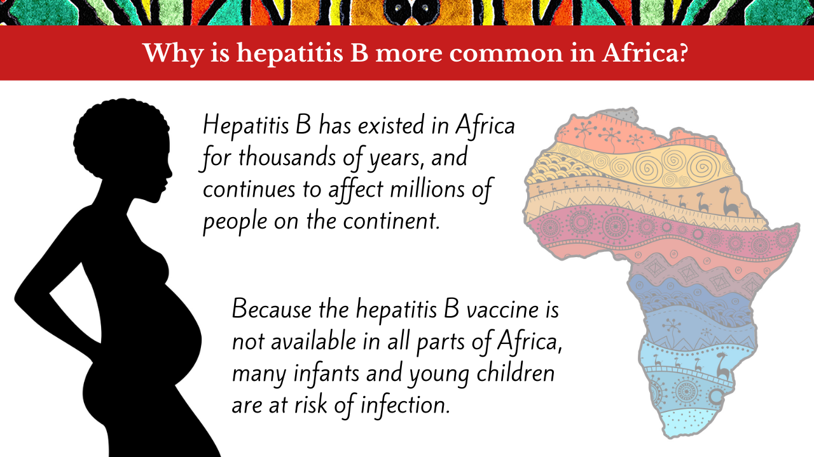

Slide 14


Slide 15
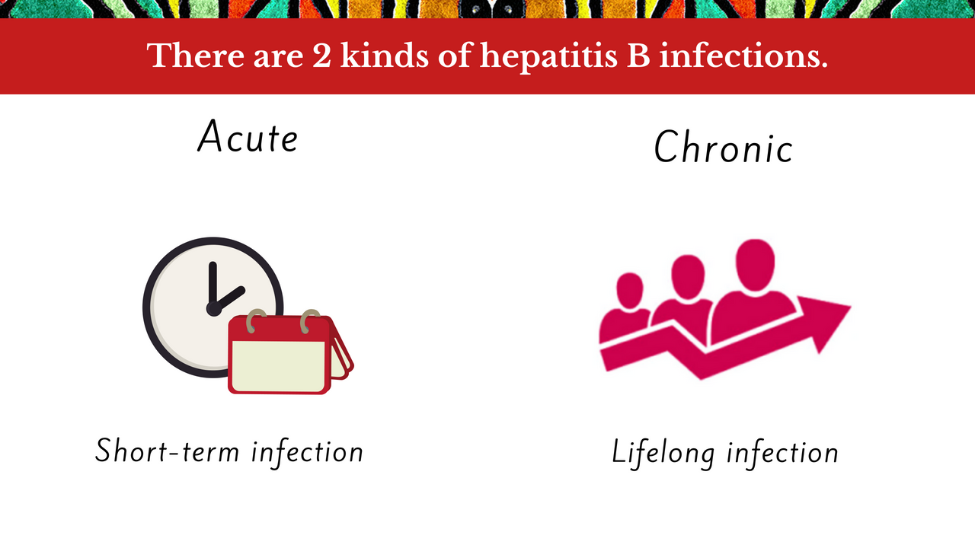

Slide 16
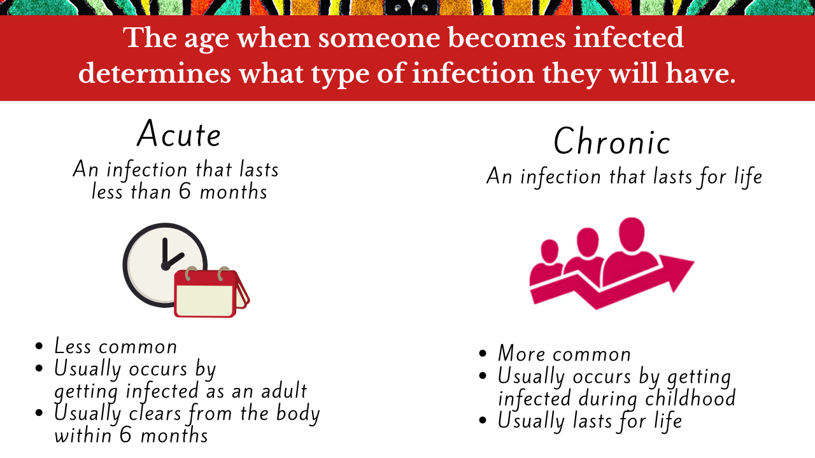

Slide 17
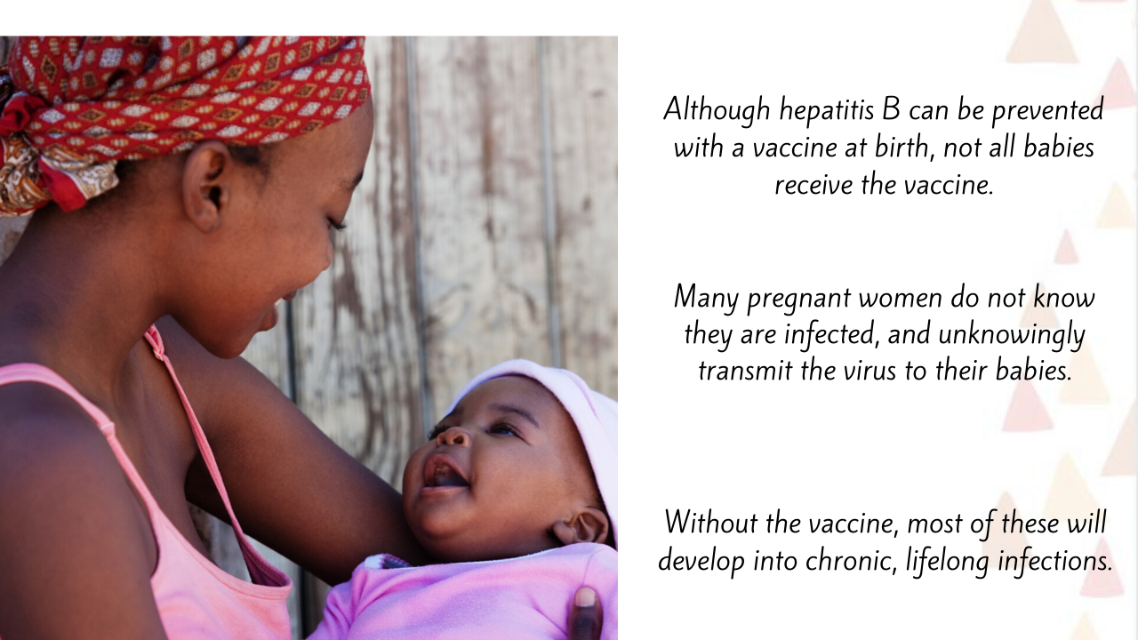

Slide 18
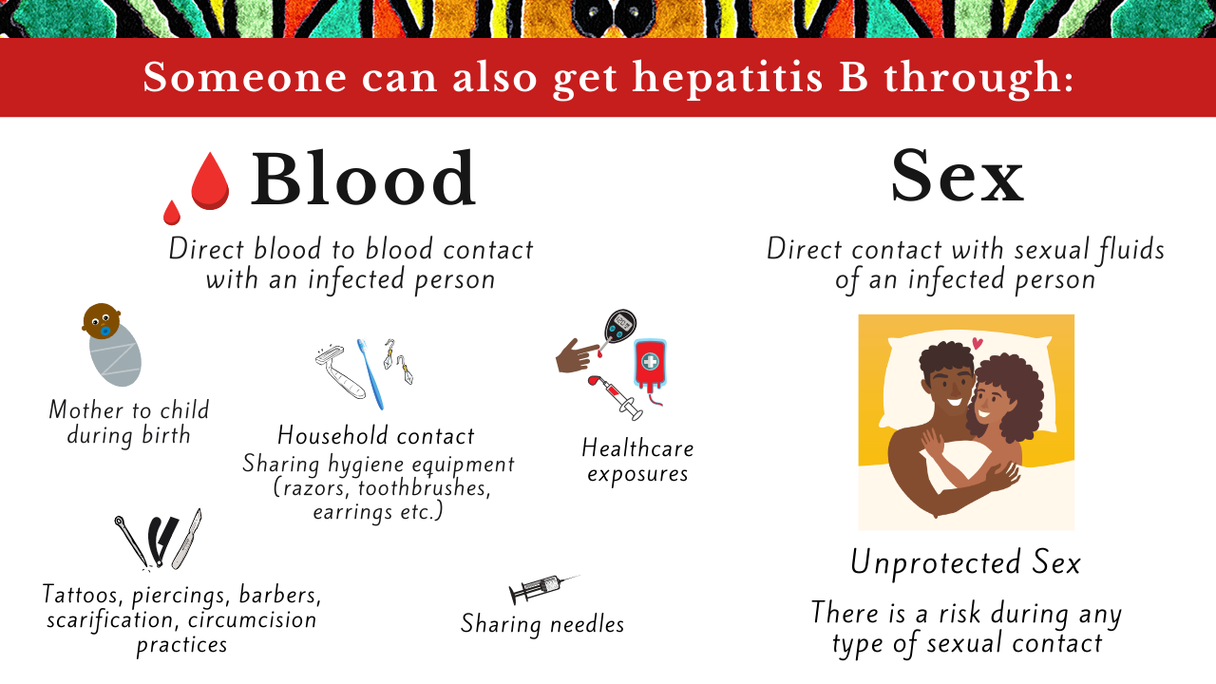

Slide 19


Slide 20
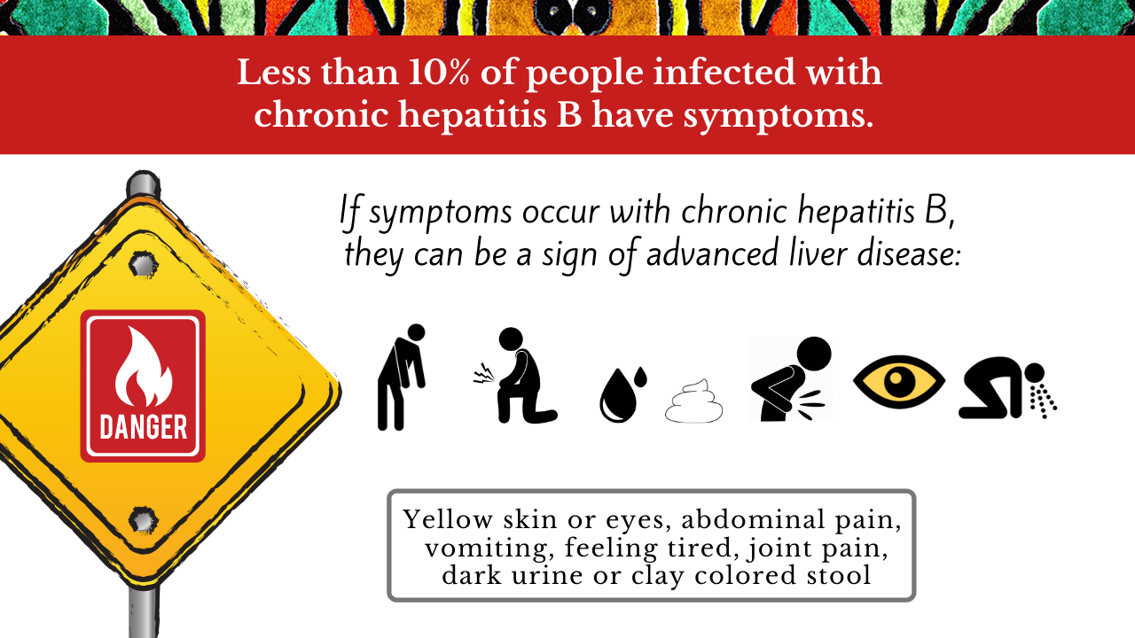

Slide 21
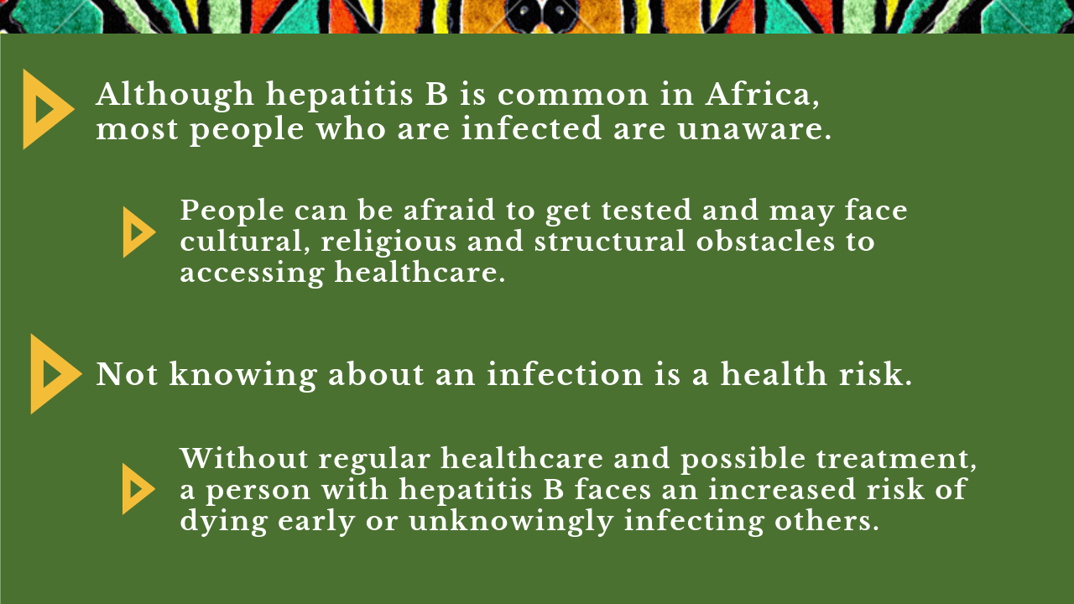

Slide 22


Slide 23


Slide 24


Slide 25


Slide 26


Slide 27


Slide 28


Slide 29


Slide 30
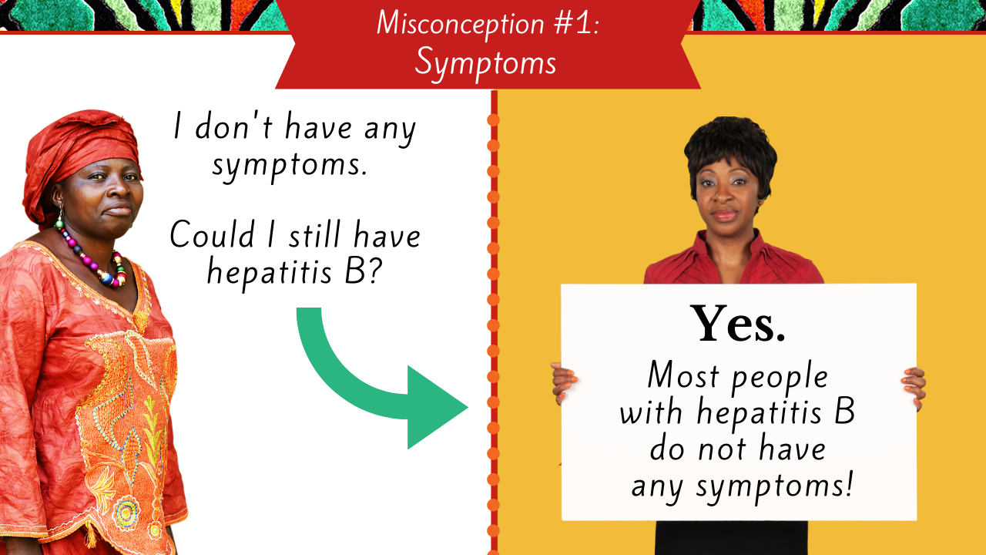

Slide 31
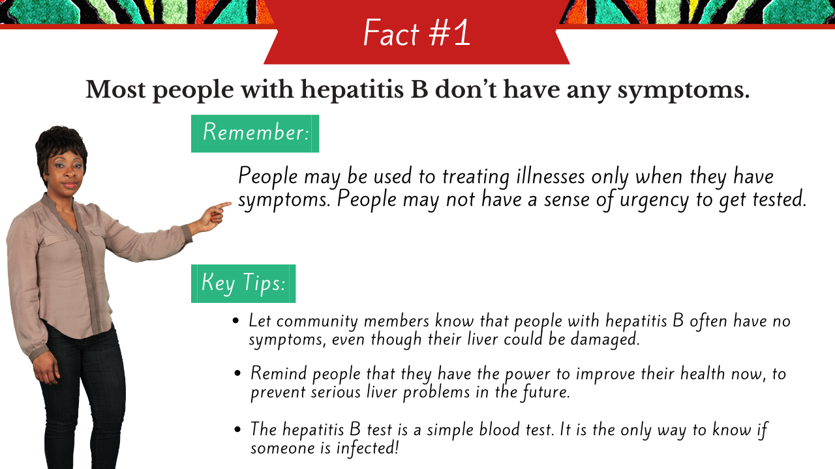

Slide 32


Slide 33
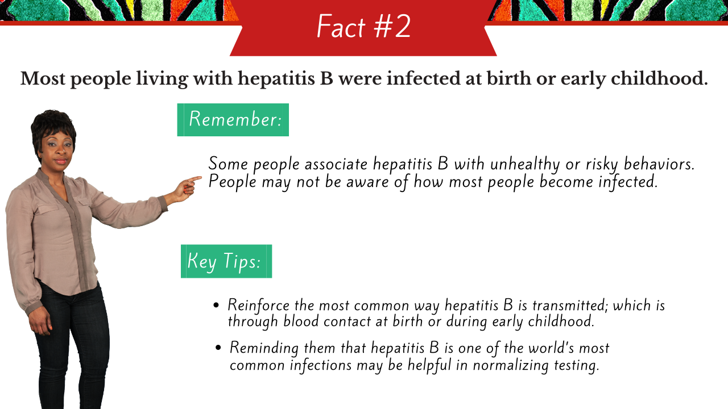

Slide 34


Slide 35


Slide 36


Slide 37
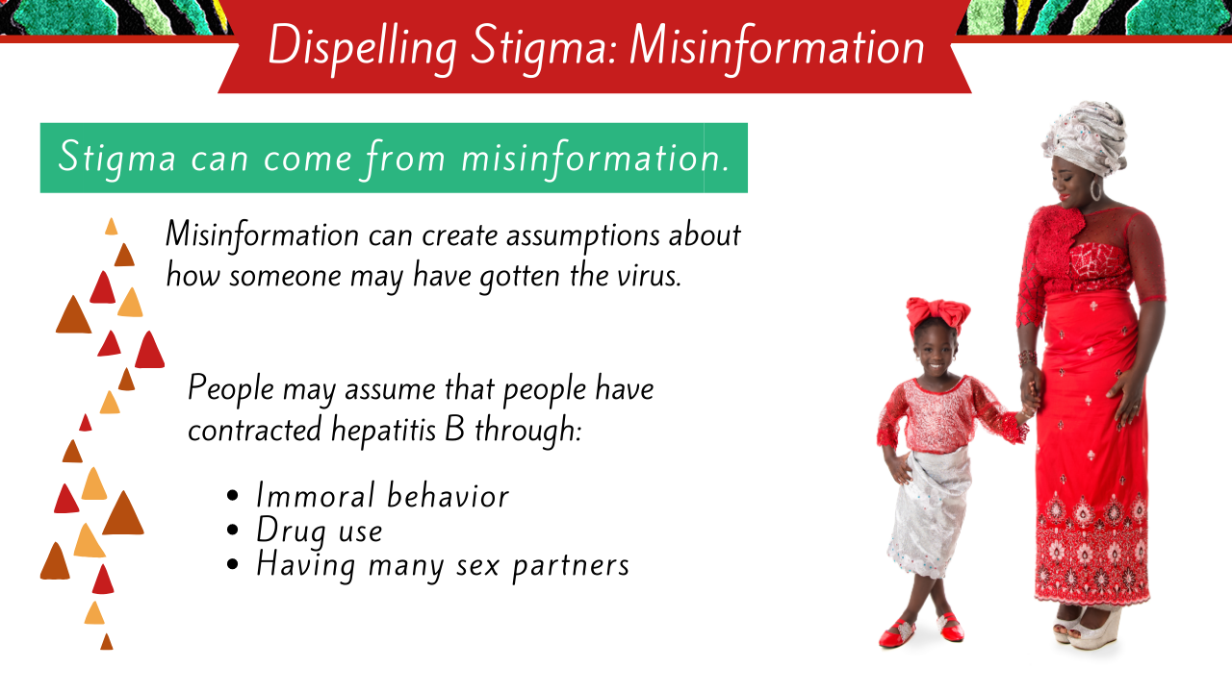

Slide 38
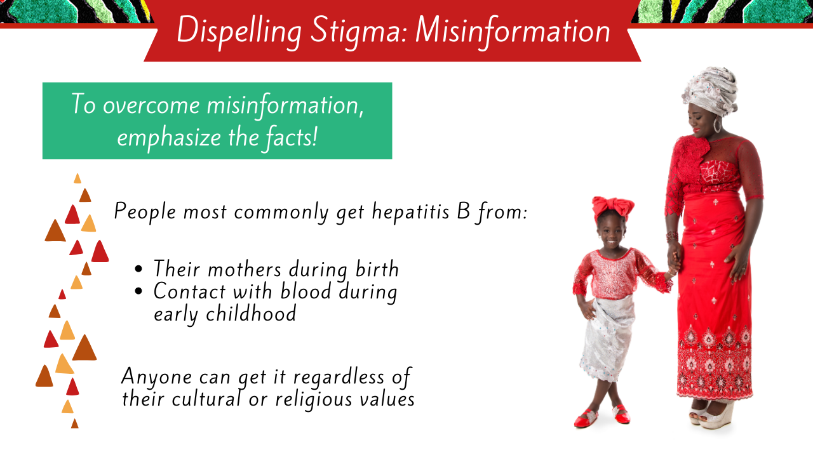

Slide 39


Slide 40


Slide 42


Slide 43


Slide 44


Slide 45


Slide 46


